Slide 1


Surveillance of avian influenza in poultry in Madagascar
Henintsoa RAVOLOLONA, Veterinarian Coordinating doctor
Respiratory Virus Genomics Workshop Tuesday 09 September 2025

Slide 2

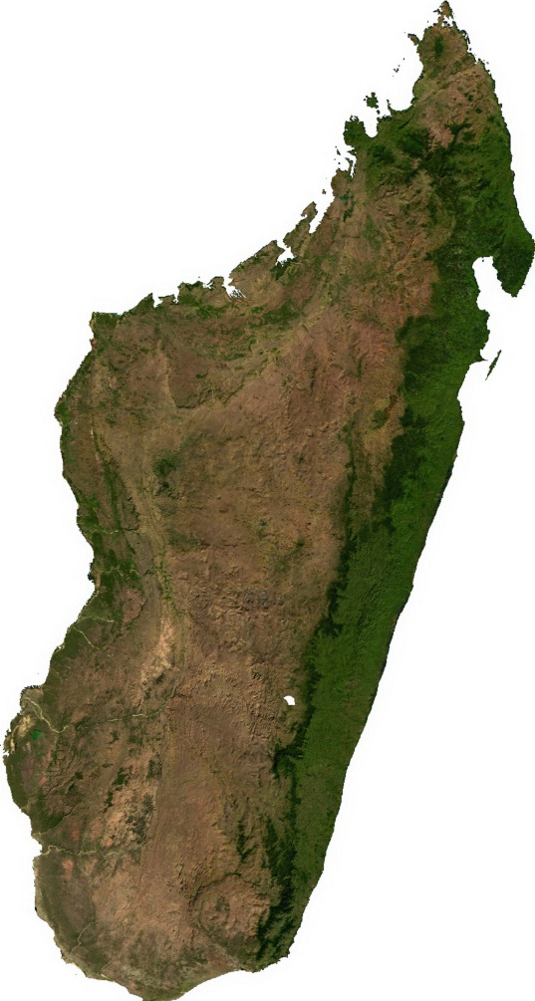
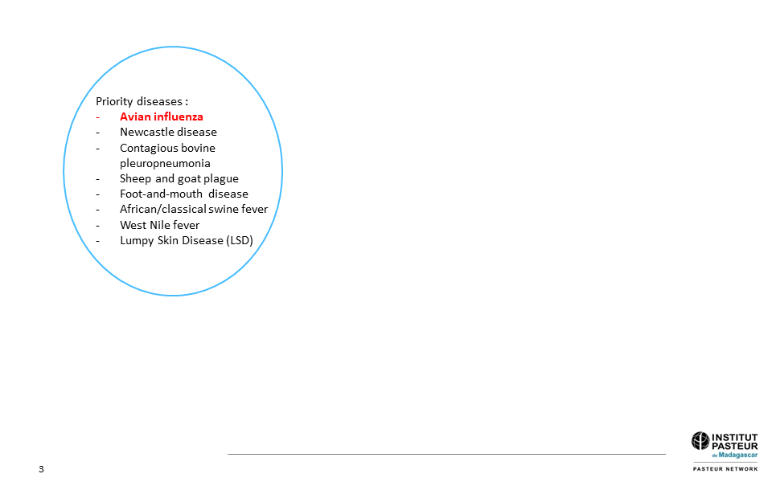
One Health collaborations
MADSUR network

Slide 3
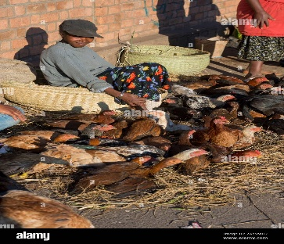
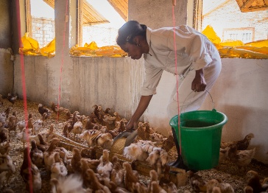
Background
Why do we need avian flu surveillance ?
Development of poultry industry
Frequency of movement of live poultry across the island
Significant importation of chicks and hatching eggs
Serological studies in some regions of Madagascar ➔presence of antibodies of avian flu in chickens and ducks
Pilot study ➔detection of low pathogenic avian influenza viruses in chickens, ducks and geese

Slide 4
Animal and zoonotic surveillance in Madagascar
Avian influenza surveillance
Lead by the Ministry of Agriculture and Livestock
Four Involved entities
Two national laboratories :
National Veterinary Diagnostic Laboratory (LNDV)
Department of Zootechnical and Veterinary Research (DRZV/FOFIFA)
Department of Veterinary Service (DSV)
Institut Pasteur de Madagascar (IPM)

Slide 5
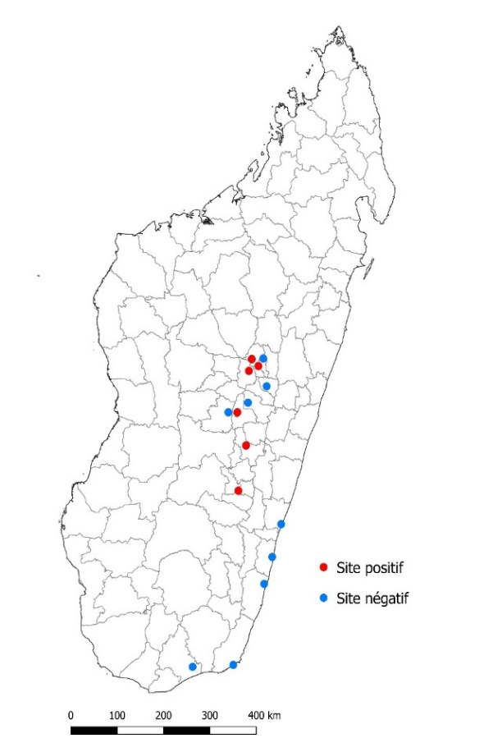
Epidemiology of avian influenza in Madagascar
2021 : Pilot study on the circulation of avian influenza in Madagascar conducted by the IPM and the DSV
Influenza A positivity rate = 11.6 % (98/842) (chicken and ducks)
A/H9 positivity rate = 39.8 % (39/98) (ducks)
Circulation of influenza A virus in domestic poultries

Slide 6
Surveillance of avian influenza in Madagascar

Slide 7

Surveillance of avian influenza in Madagascar
In collaborating with Department of Veterinary Service (Ministry of Agriculture and Livestock)
General objective :
To establish long-term surveillance of avian influenza in Madagascar
Specific objectives :
To characterize circulating strains and track their genetic evolution
To identify potential seasonality
To identify the source(s) of introduction of circulating viruses
To establish the level of risk for animal and human health

Slide 8
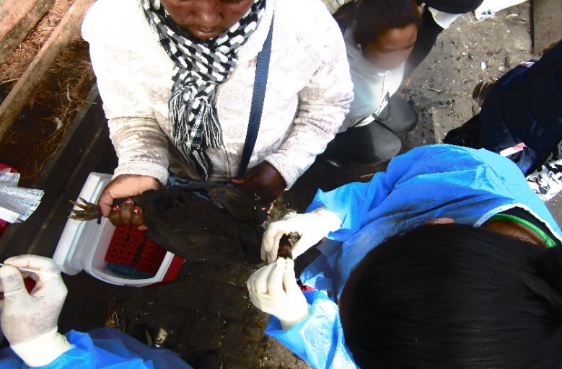
Methods (1) : Sampling collection
1. Sampling period : October 2021 to August 2025
2. Collection sites :
Markets : Anosibe, Ambodinisotry, Andravoahangy
Border : Ivato International airport (imported chicks)
3. Types of swabbing :
Tracheal
Cloacal
4. Spieces sampled :
Chicken
Duck
Goose

Slide 9
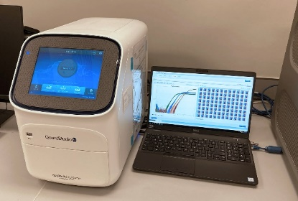
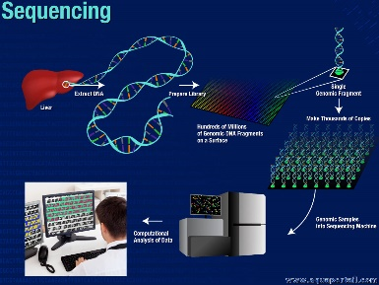
Methods (2) : Laboratory analysis
PCR Screening of influenza A
PCR Subtyping for A/H9, A/H7, A/H5
Whole genome sequencing by NGS
Ct <28
Genomic analysis

Slide 10
Results (1) : Sample description
N=11,577
Markets
N=11,363
Chicken
n=3,289
Duck
n=6,084
Border
N=394
Chicken
n=394
Total
Collection sites
Species
Goose
n=1,810
From October 2021 to August 2025

Slide 11
Results (2) : Screening of influenza A
Total
N=11,577
Positive for Flu A
N=1014 (8.8%)
Ducks
n=88 (91.7%)
Unsubtypable
N=911 (89.8%)
Negative for Flu A
N=10,563 (91.2%)
Ducks
N=7 (100%)
Flu A/H5
N=0
Flu A/H9
N= 96 (9.5%)
Chicken
n=7 (7.3%)
Goose
n=1 (1%)
Flu A/H7
N=7 (0.7%)
From October 2021 to August 2025
288 Flu A positive samples
Genome sequencing

Slide 12
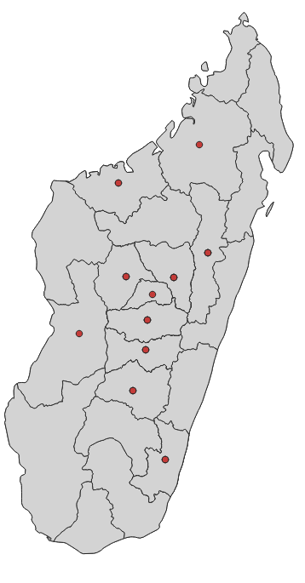
Results (3) : Distribution of positive cases by origin
Influenza A positivity rate by origin
Region | Total | Flu A
Alaotra Mangoro | 1123 | 6.9 (77/1123)
Amoron'i Mania | 140 | 14.3 (20/140)
Analamanga | 1977 | 7.2 (132/1845)
Atsimo Atsinanana | 772 | 1.6 (12/772)
Boeny | 573 | 3 (17/573)
Bongolava | 683 | 0.9 (6/683)
Haute Matsiatra | 1869 | 9 (169/1869)
Itasy | 88 | 21.6 (19/88)
Menabe | 55 | 21.8 (12/55)
Sofia | 267 | 4.1 (11/267)
Vakinankaratra | 3162 | 17 (538/3162)

Slide 13
Positive for Flu A
N=1112
Sequenced samples (n=288)
- A/H9=119
- A/H7=3
- Unsubtypables=166
Unsequenced samples
n=824
Sequenced generated
n=184
Partial genome
n=33
Complete genome
n=151
Results (4) : NGS sequencing
A/H9N2 (n=59)
A/H6N1 (n=24)
A/H4N6 (n=23)
A/H6N2 (n=19)
A/H11N2 (n=10)
A/H1N2 (n=7)
A/H7N7 (n=3)
A/H6N8 (n=3)
A/H9N6 (n=3)
Sequences submitted to GISAID : 73 samples ➔466 sequences

Slide 14
Results (5) : Subtype distribution by species
Species | Subtypes | Number
Ducks | A/H9N2 A/H6N1 A/H4N6 A/H6N2 A/H11N2 A/H1N2 A/H9N6 A/H7N7 A/H6N8 | 51 23 20 16 10 7 3 3 3
Chicken | A/H9N2 A/H6N2 A/H4N6 | 6 2 2
Goose | A/H9N2 A/H6N2 A/H6N1 A/H4N6 | 2 1 1 1
One (1) duck co-infected by A/H1N2 and A/H4N6
One (1) chick from Brazil infected by A/H4N6

Slide 15
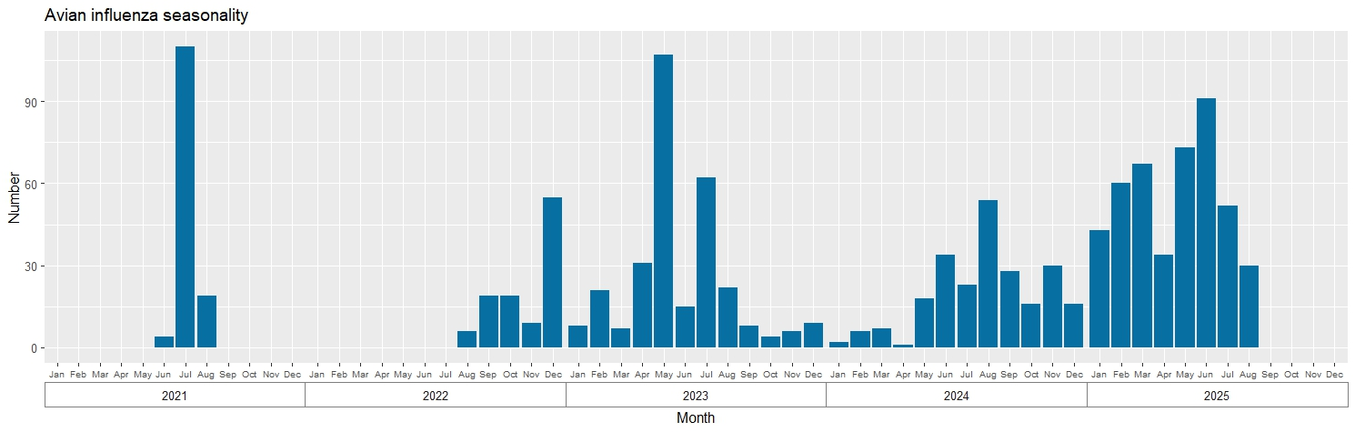
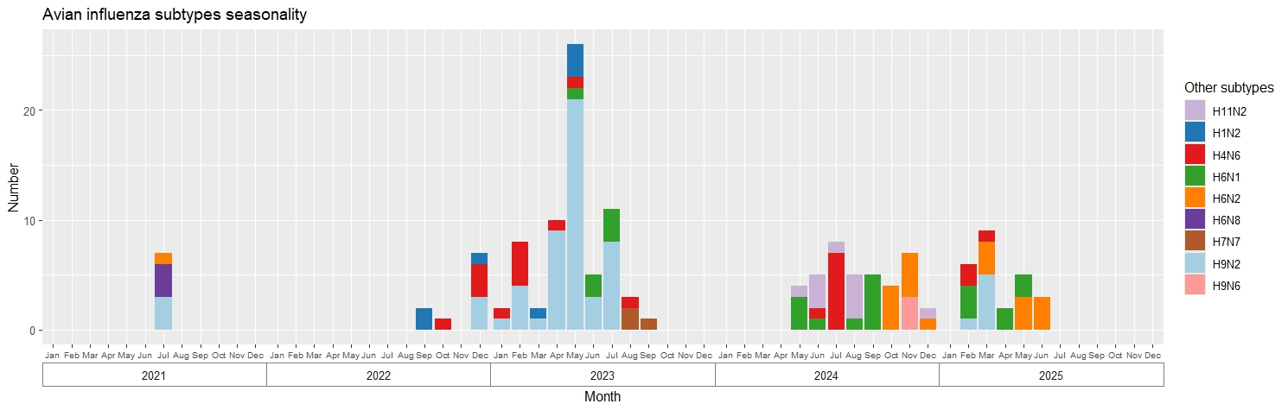
Results (6) : Temporal distribution of avian influenza viruses

Slide 16
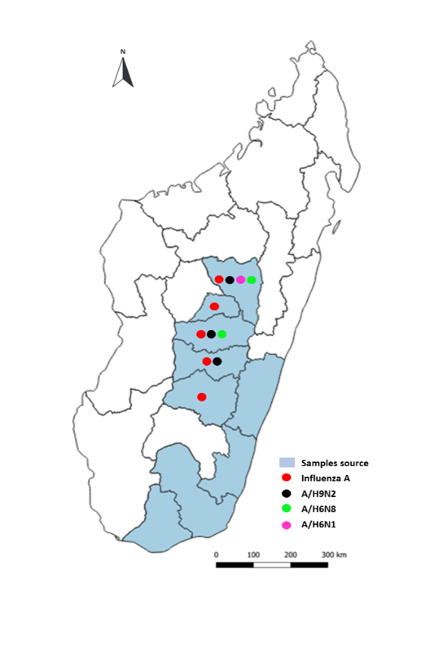
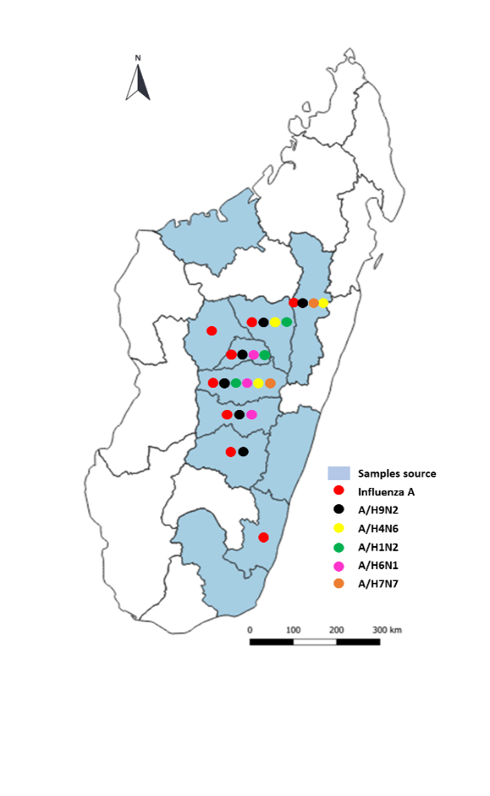
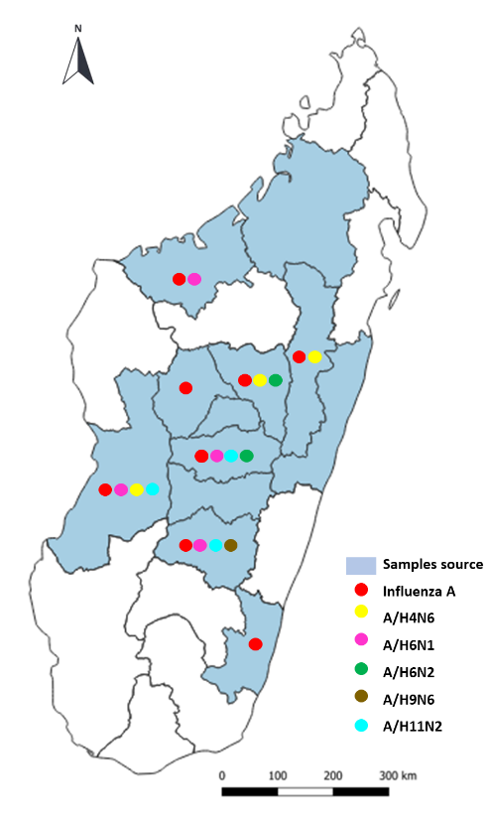
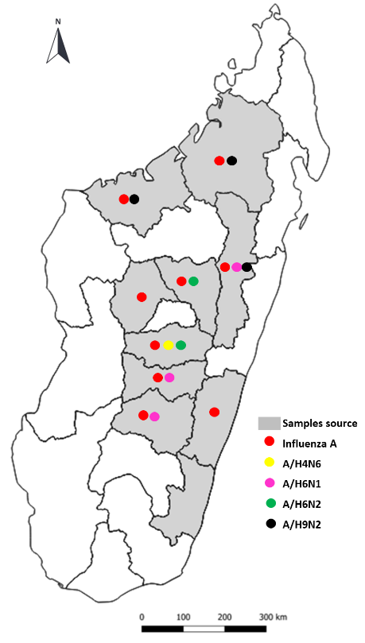
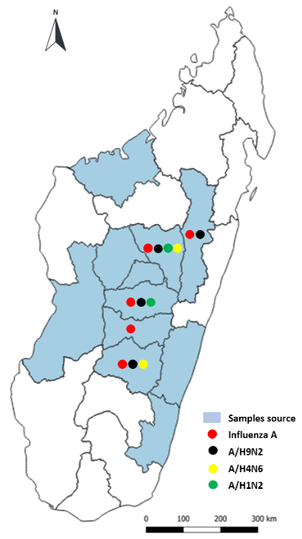
Results (7) : Geographical distribution of avian influenza viruses
2021
2022
2023
2024
2025

Slide 17
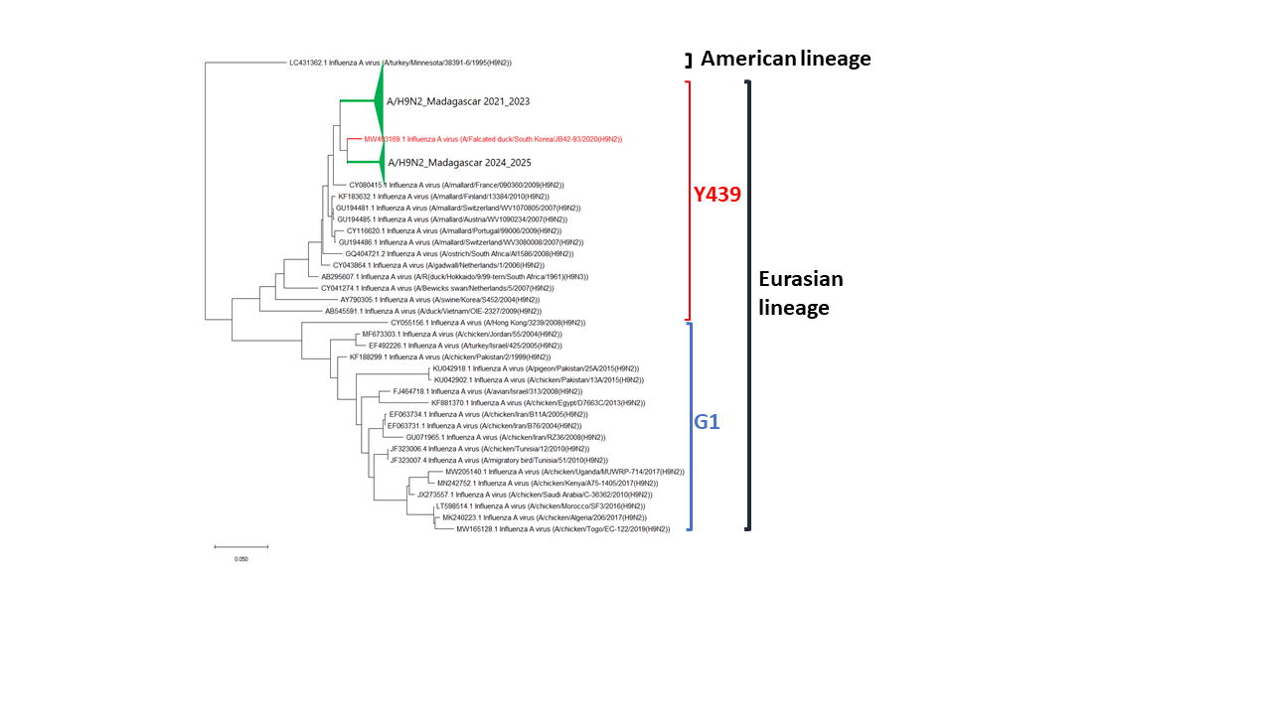
Results (8) : Phylogenetic analysis

Slide 18
Challenges and suggestions to improve coordination

Slide 19
Challenges
Surveillance of avian influenza :
Lack of real coordination between Ministries (Health; Animal and Environment) and between laboratories
Difficulty of local procedures
Sustainable funding
Lack of knowledge regarding the epidemiological and ecological profile of avian flu (need capacity buildings)

Slide 20


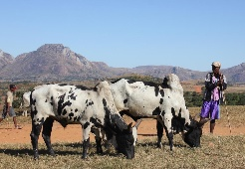



Barriers to timely information sharing
Communication issue : funding gap ➔lack of communications equipment
Laboratories
Farmers
Veterinary health officer
Veterinary Service Department
Human health
Animal health
Environment health

Slide 21
Success stories
Avian influenza surveillance :
Detection of influenza A virus circulation à Mada
Establish a national network for surveillance of avian influenza
Simulation exercise on the implementation of responses in the event of avian influenza detection in Madagascar (June 2023)
Implementation Sequencing
Include national partners working in biological conservation
Next step :
Update of the contingency plan for highly pathogenic avian influenza in Madagascar (September 2025)
Site extension (Wild bird lakes - soon)

Slide 22
Lesson learnt
Importance implication DSV (Ministry of Agriculture and Livestock)
Involvement of Regional veterinaries
Importance of collaborating with bird biologists and ecologists
Importance of communication

Slide 23
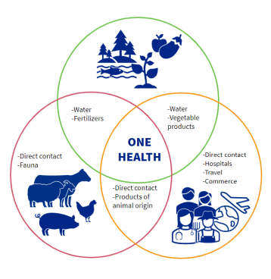
Suggestions to improve One Health collaborations
Integration of other diseases to be monitored in the SEGA ONE health Madagascar network (all priority diseases)➔ funding ➔ continuous surveillance
Contribution from all entities in the network
Improved communication between all relevant entities

Slide 24
Thank you for your attention

